Slide 1


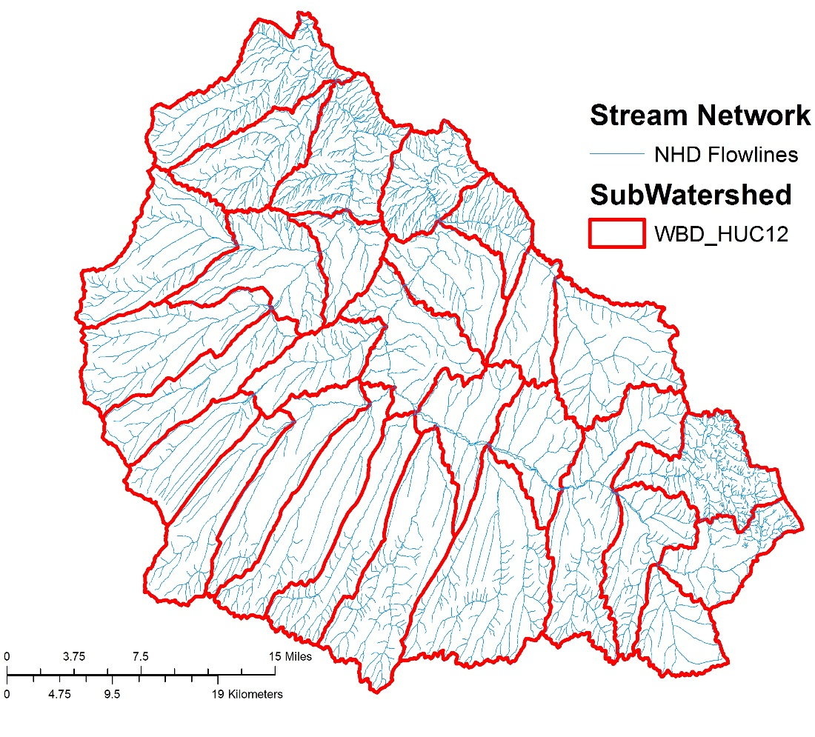
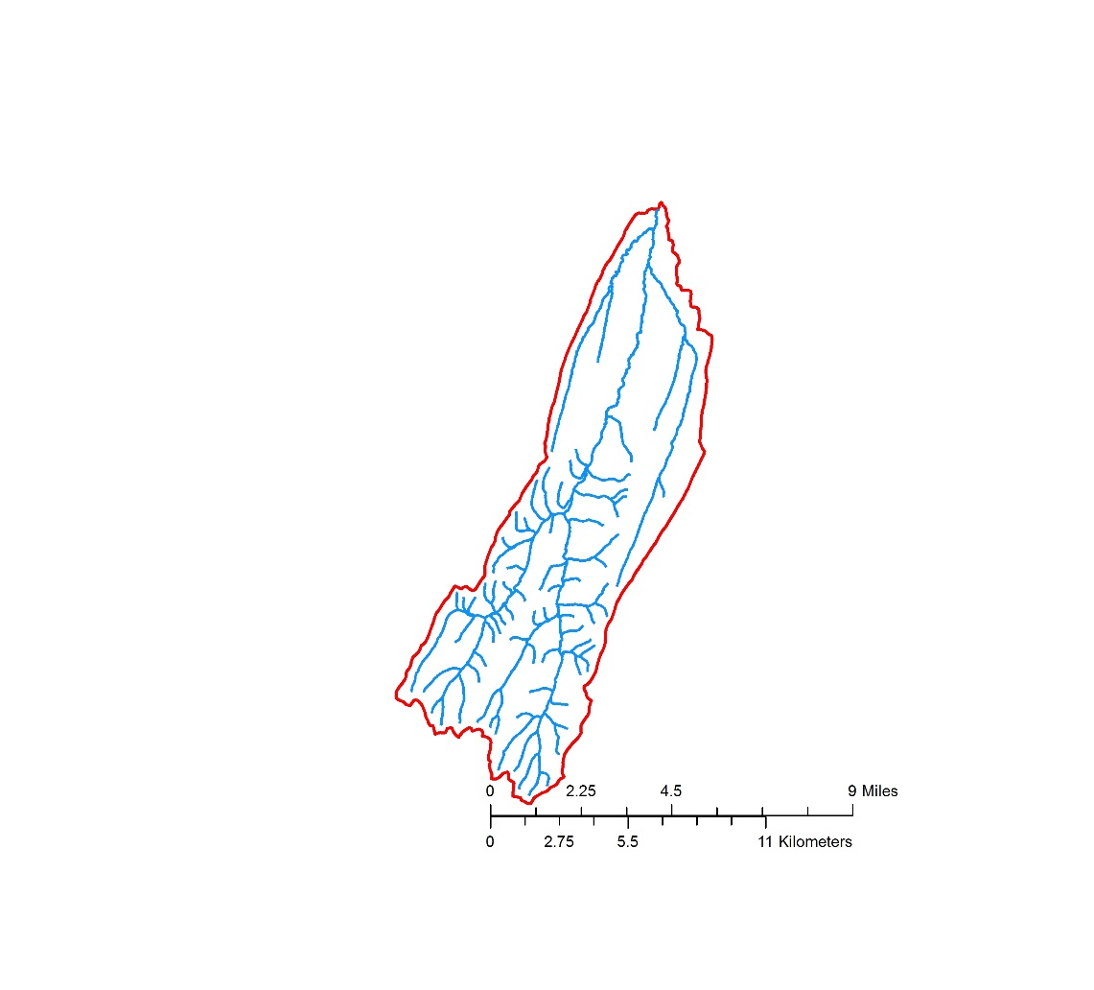
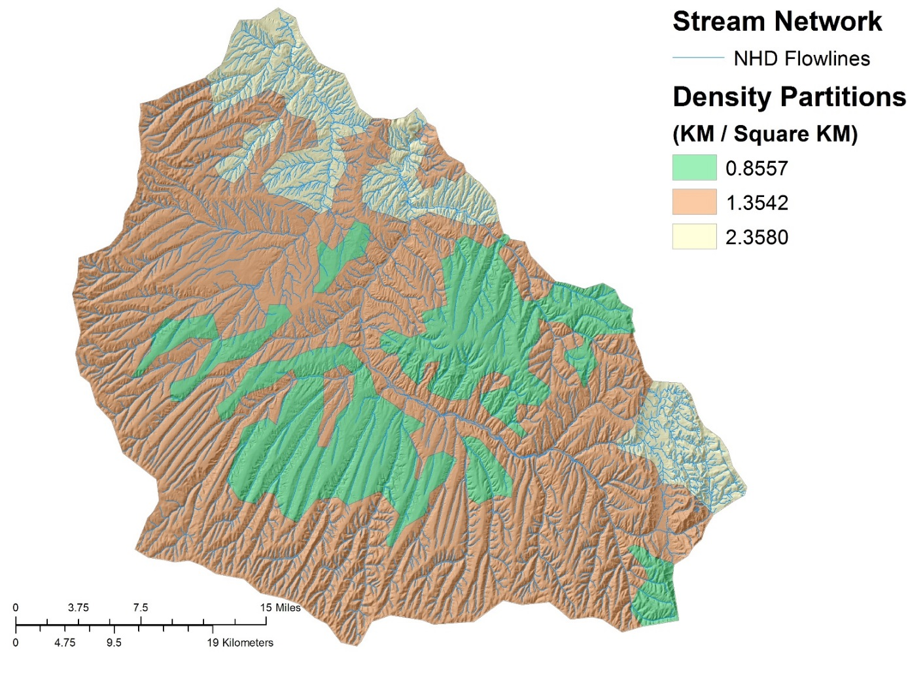
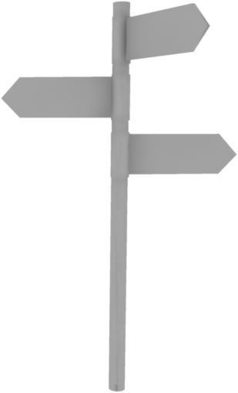



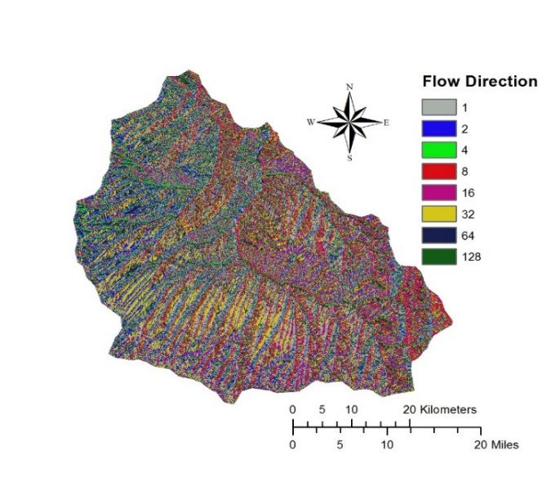
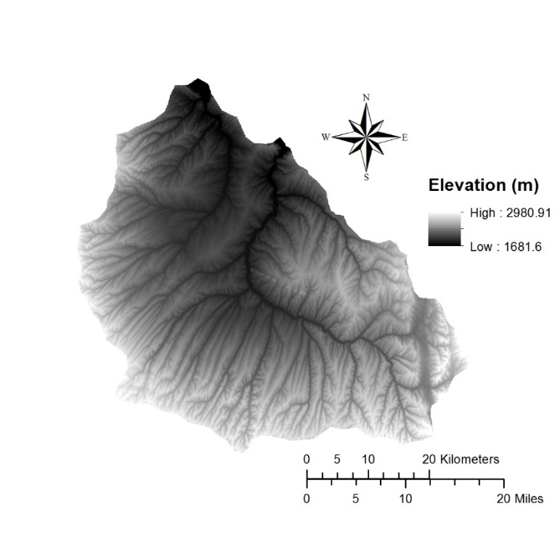
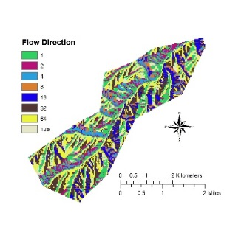
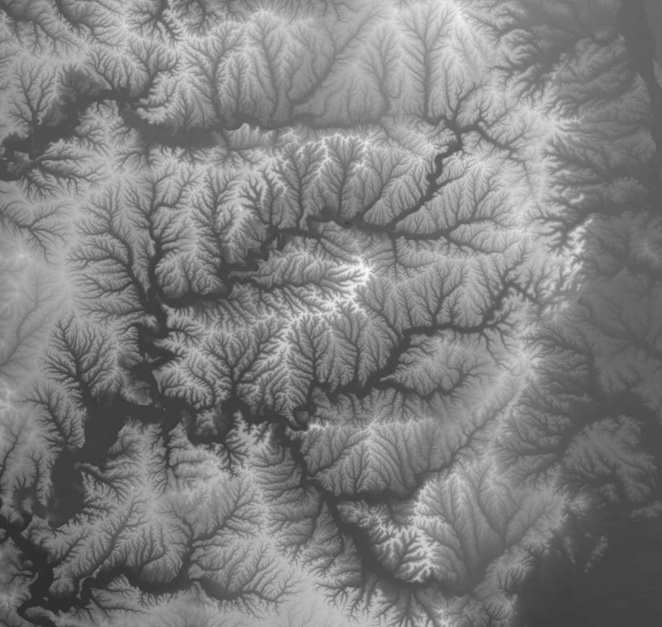
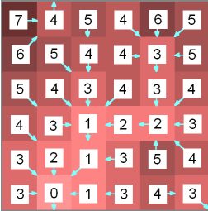
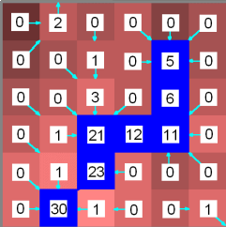
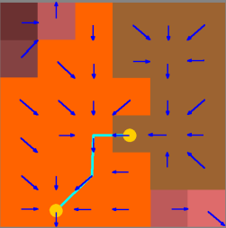

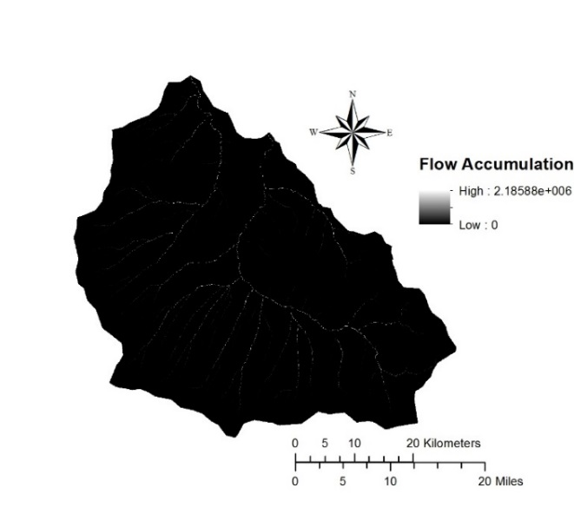
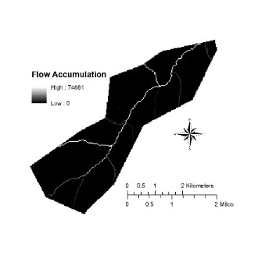
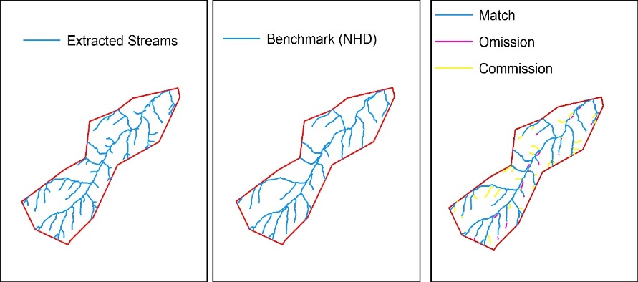
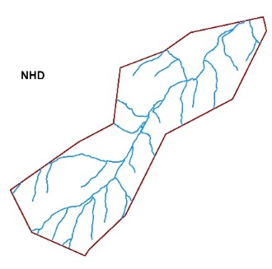
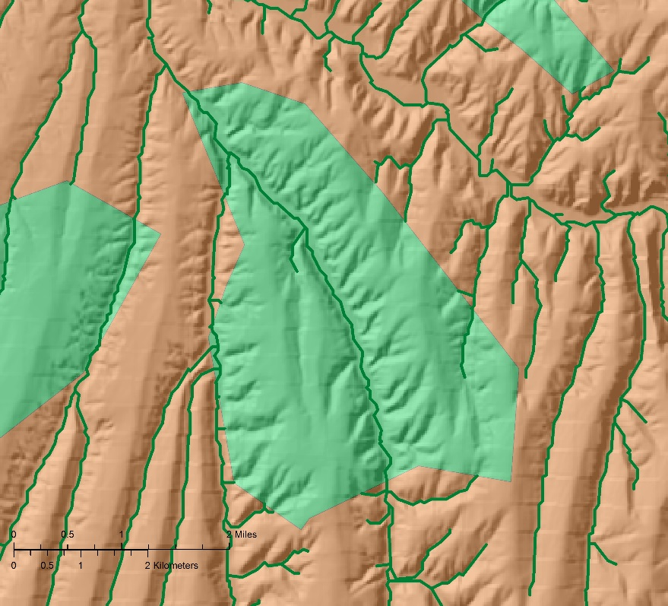
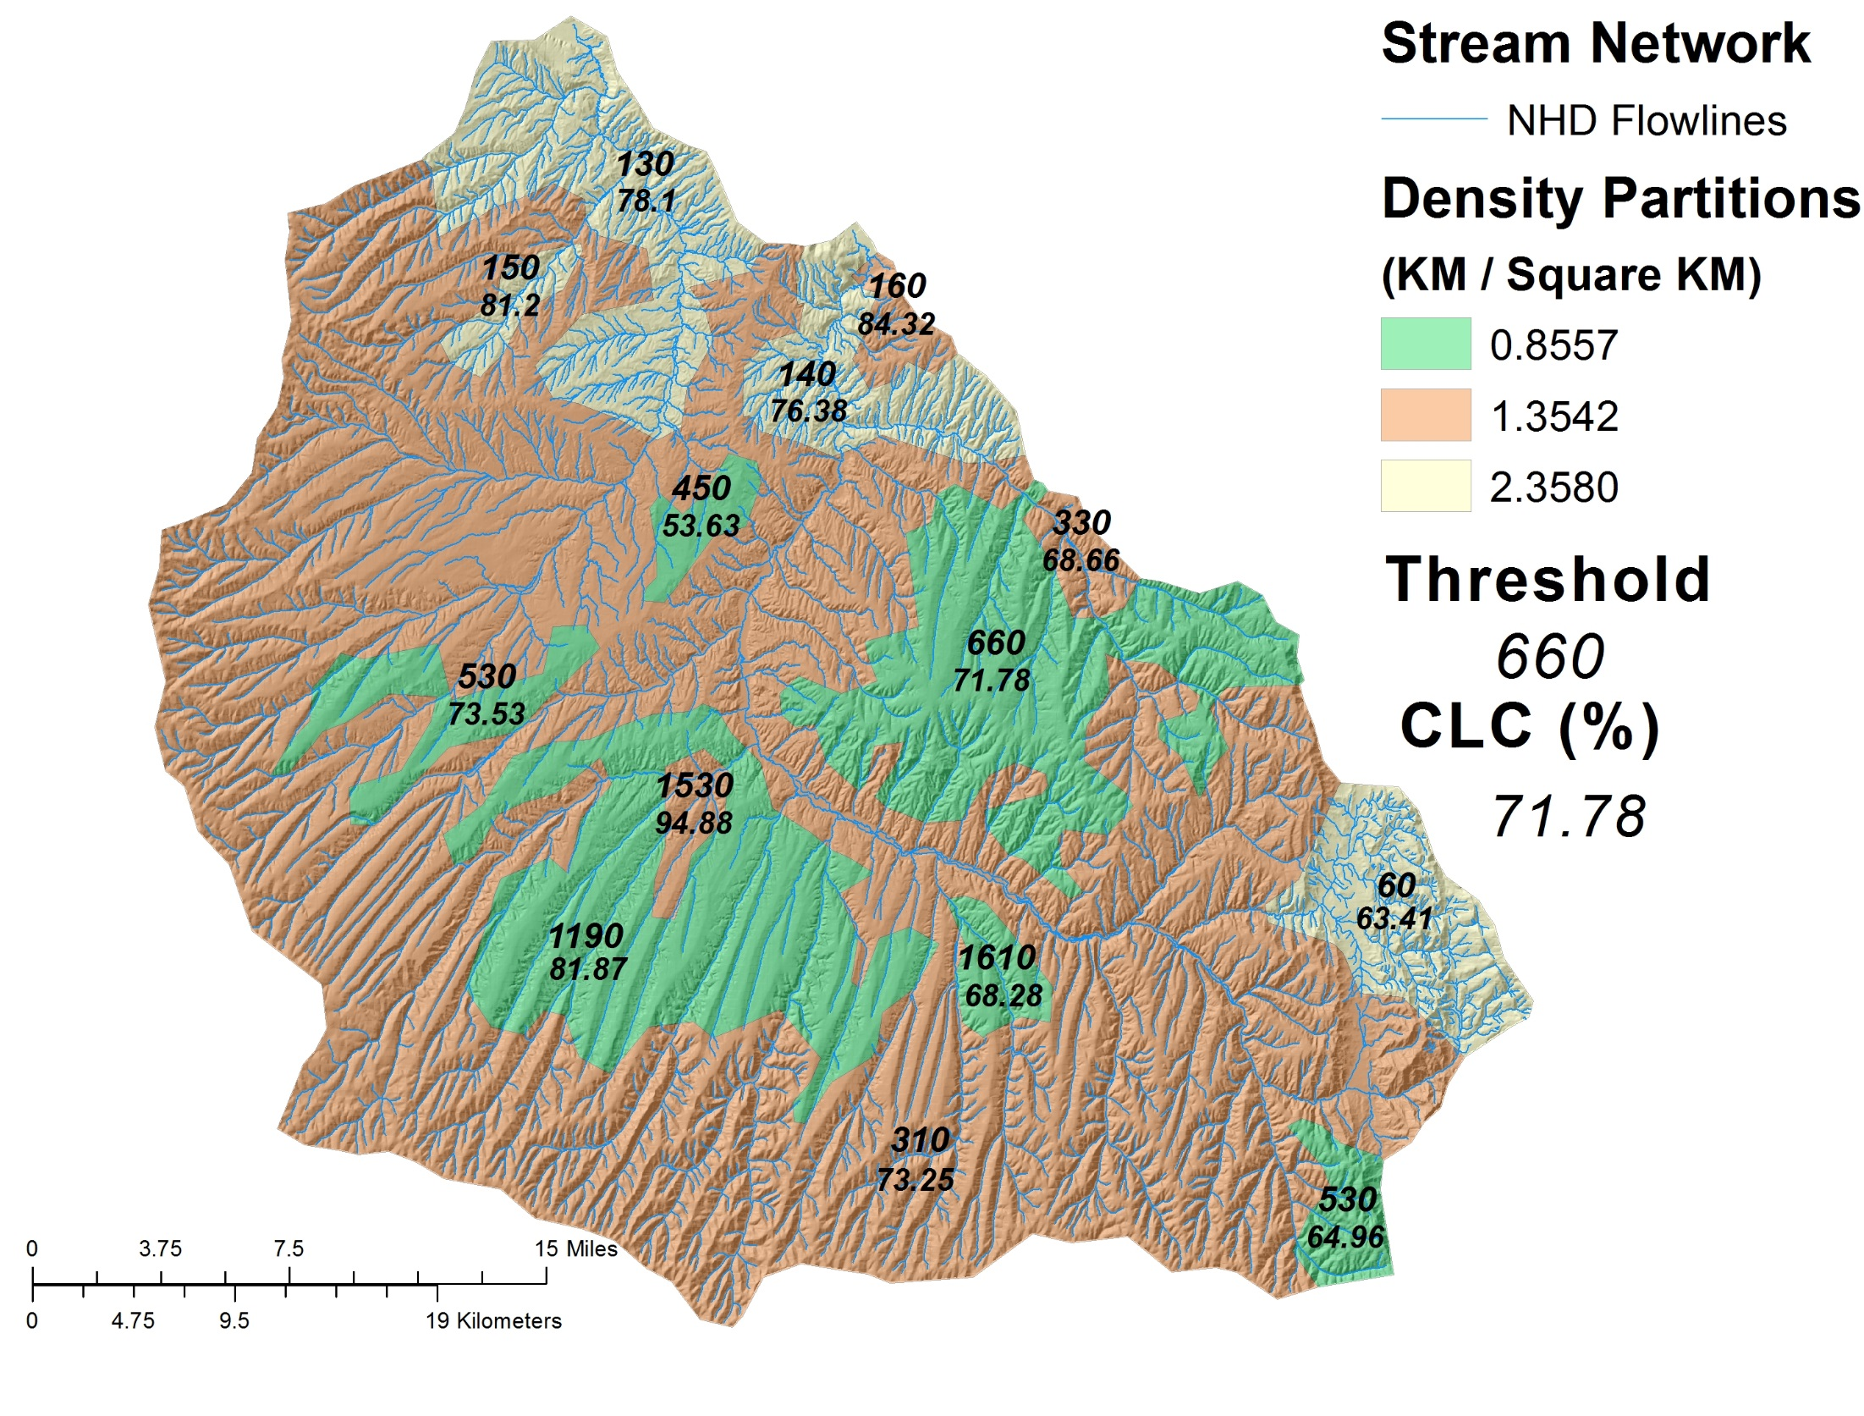
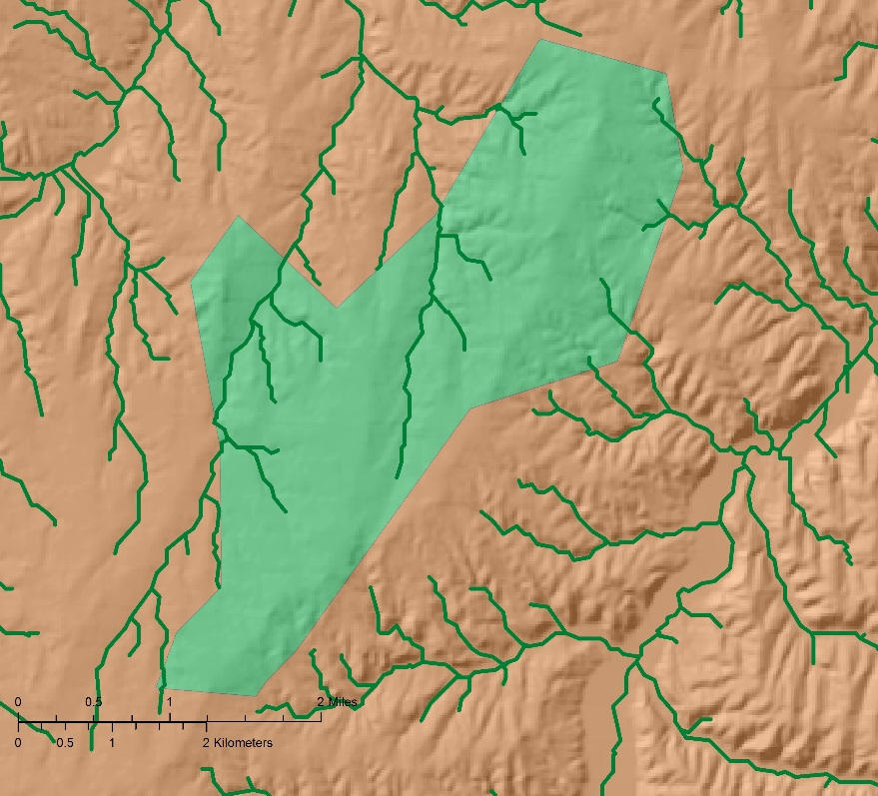
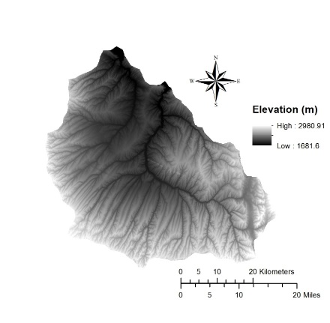
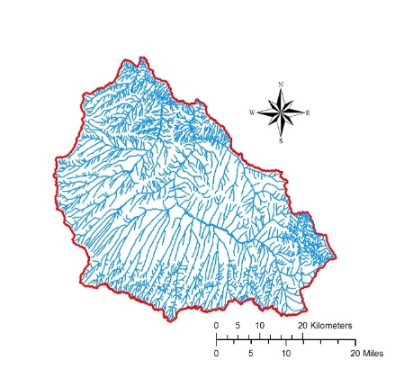
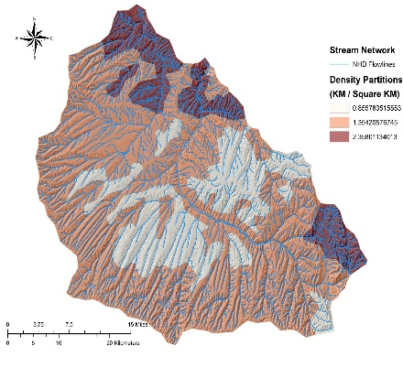
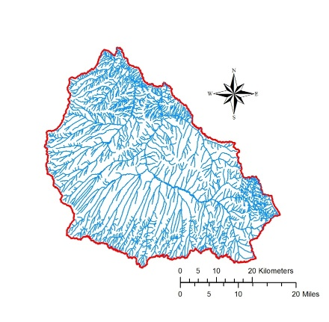
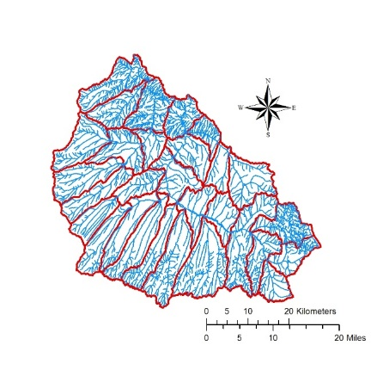
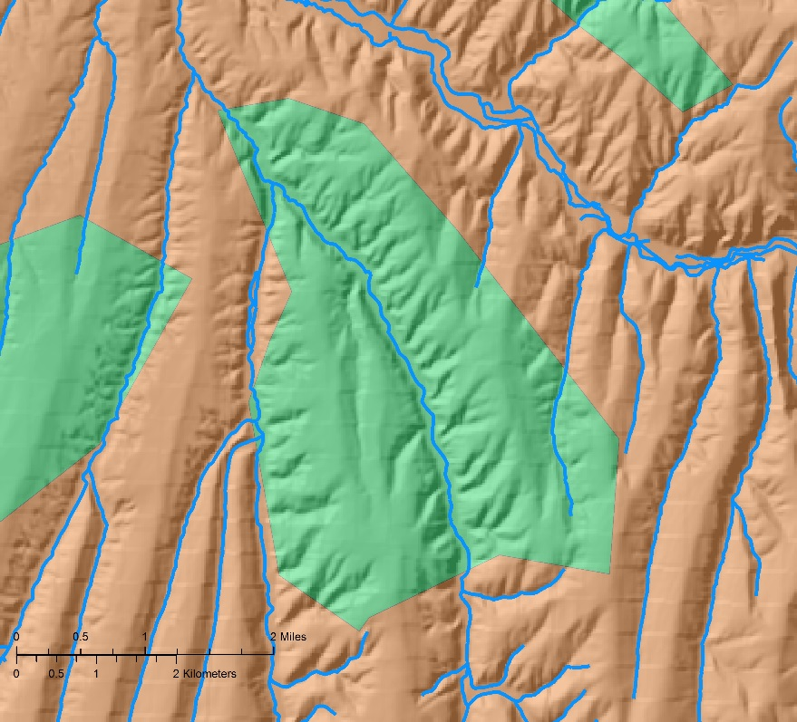
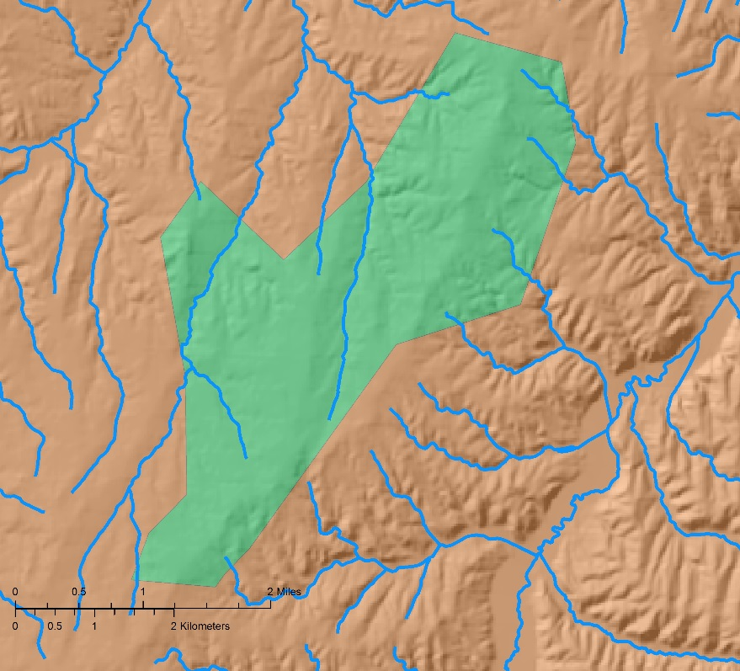
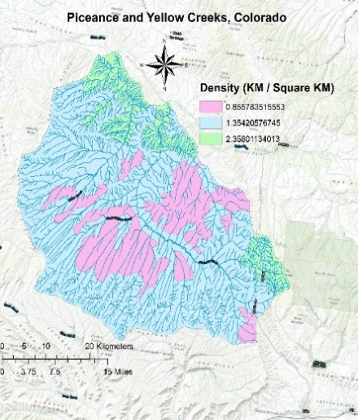
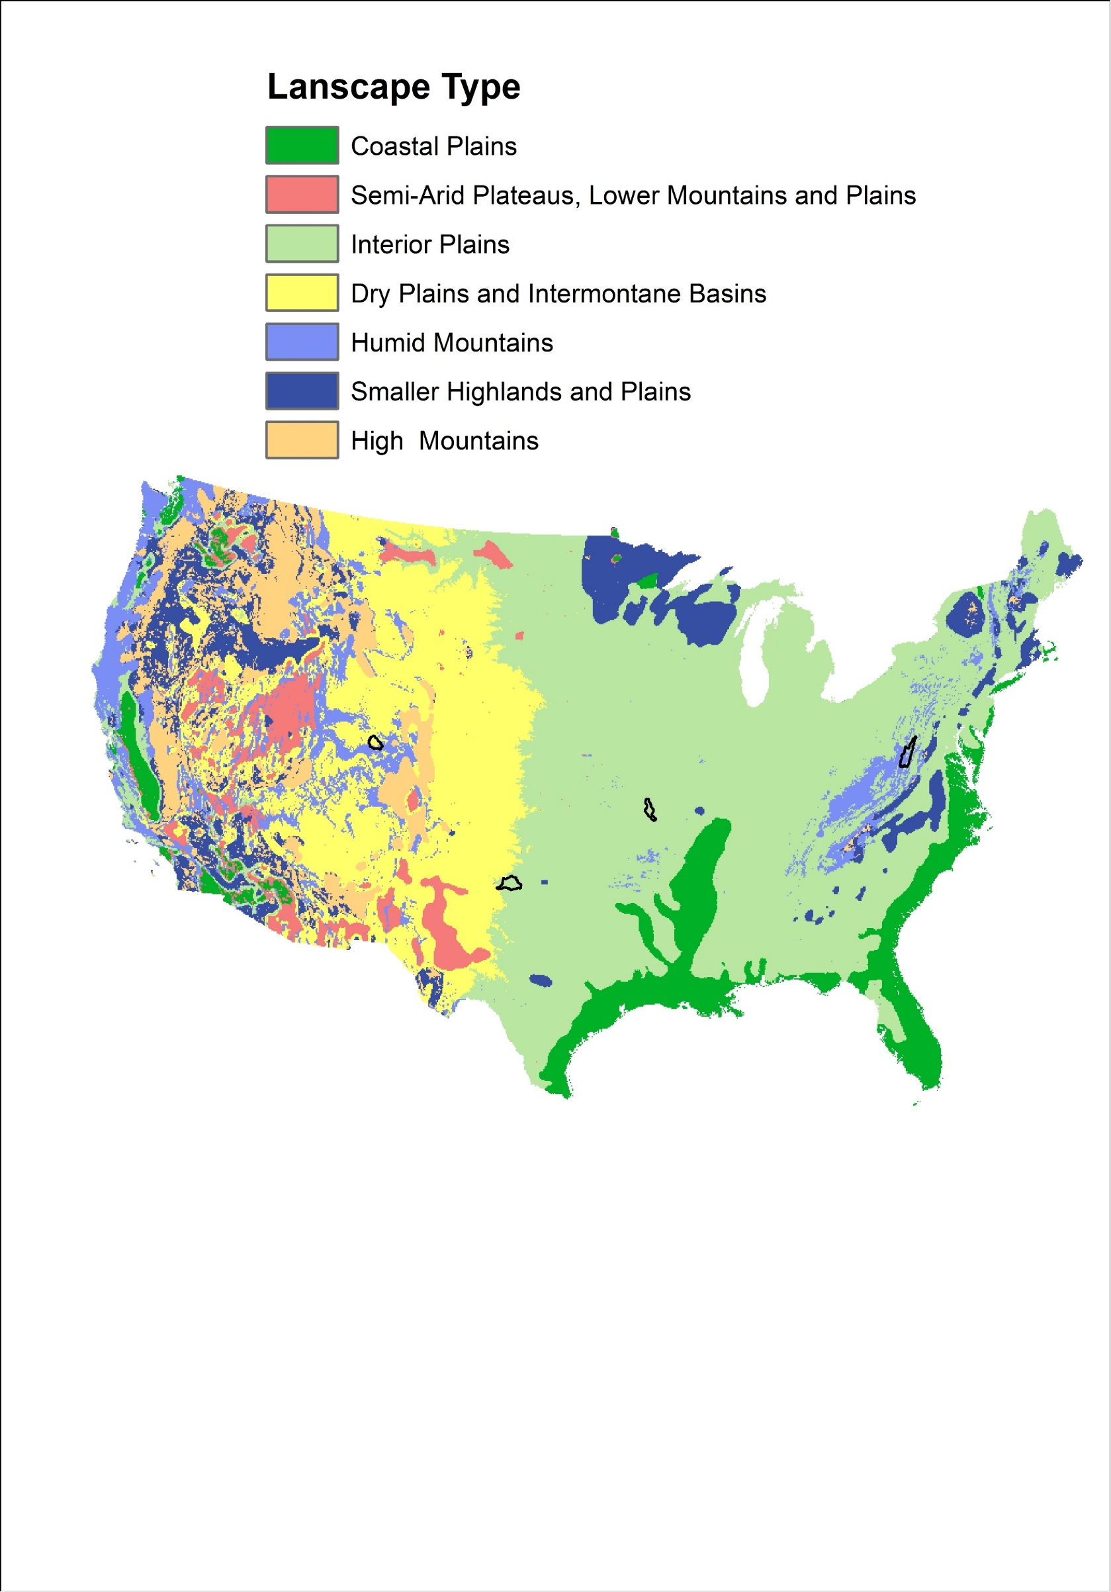
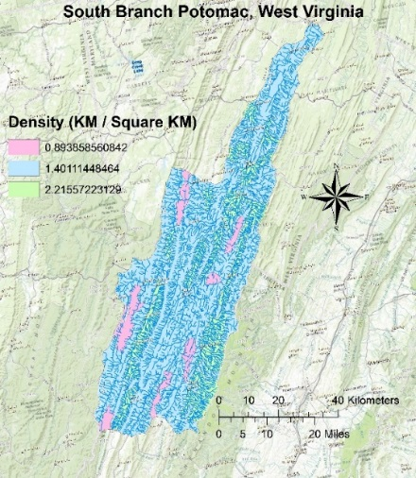
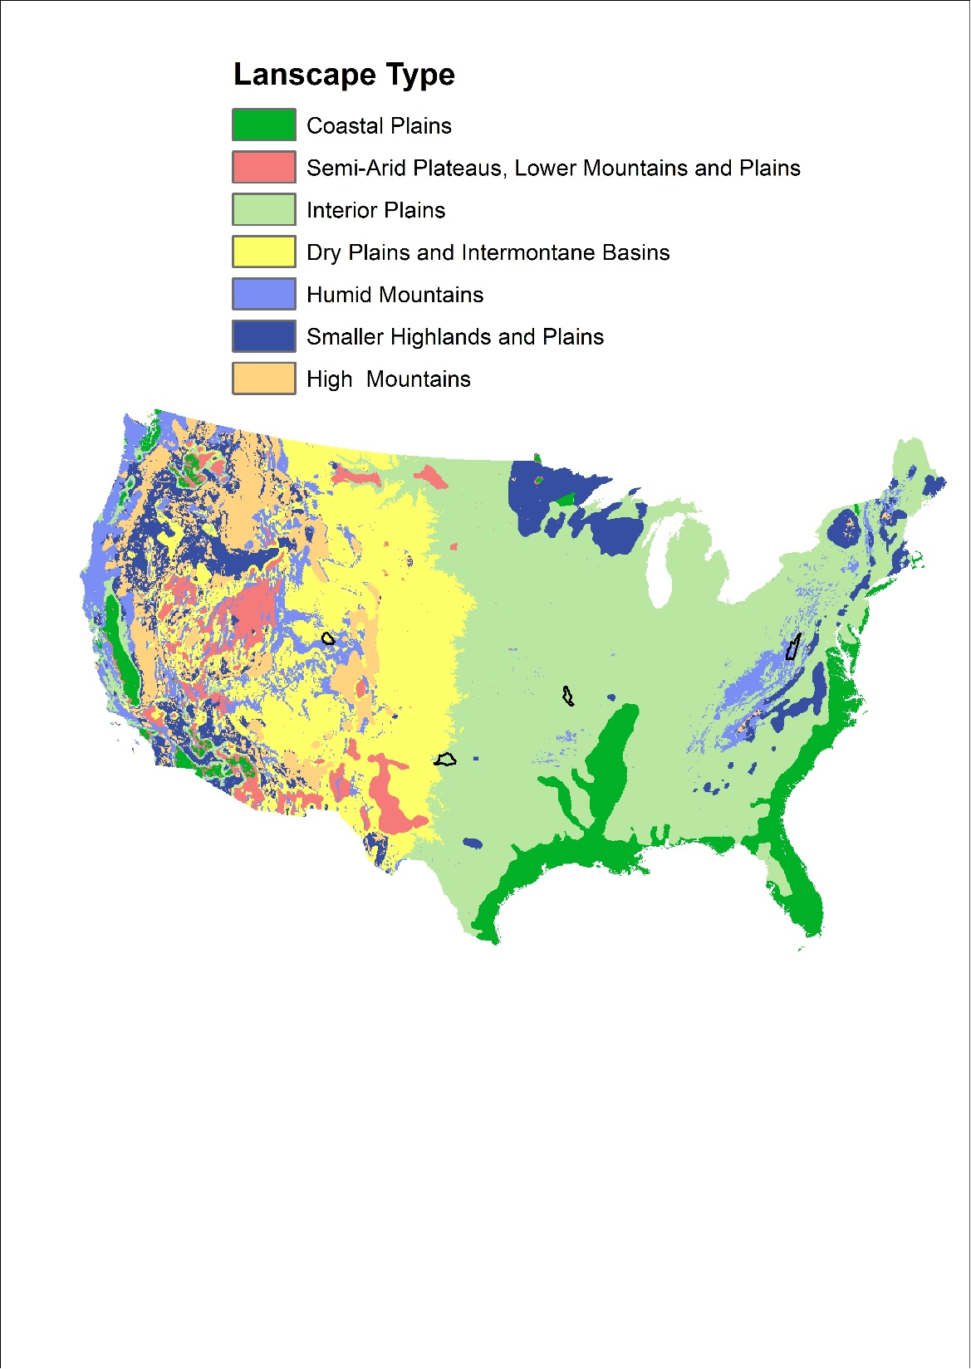
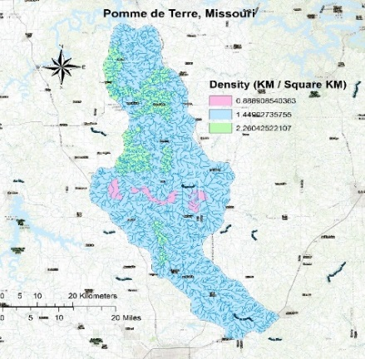
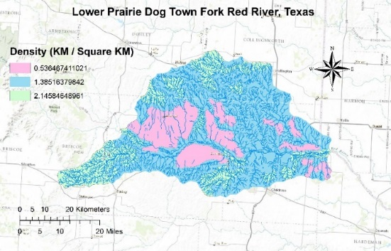

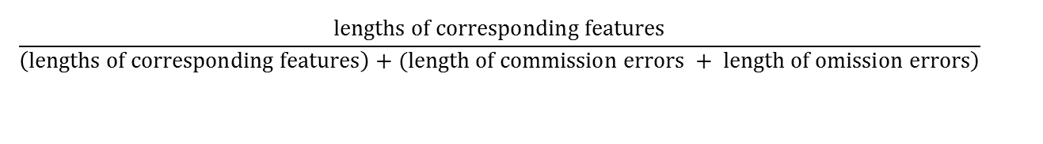
Density-Based Stream Network Extraction from Digital Elevation Models
Mehran Ghandehari, Barbara P. Buttenfield
Meridian Lab, Department of Geography, University of Colorado-Boulder
Introduction
Method
Conclusion
Digital Elevation Models (DEMs) are widely used for stream network extraction. DEM-based methods track the simulated flow of water to calculate flow direction and flow accumulation (Tarboton et al, 1991).
Stream network delineation depends on several factors:
a) DEM Resolution (1m vs. 30m vs. 90m)
b) Flow Direction algorithm (D8 vs. D-infinity)
c) Flow Accumulation Threshold
The most common way to determine a cutoff threshold is by trial and error, which can be time consuming, inconsistent from one location to another, and possibly erroneous (if an inappropriate threshold value is selected).
HUC12
Density partitions
Choosing one threshold for extracting streams from DEM leads to inaccurate results
Using density partitions for extracting streams from DEM improves the results
There is a correlation between threshold and CLC and also between threshold and density
Some of the small CLC values are related to DEM-based method problems (e.g., flat areas, water bodies), which more investigation is required
Most of the errors in the extracted streams are related to the first order streams (head waters)
Step 1
Flow direction and flow accumulation are calculated for the whole study area
Step2
Then the flow accumulation and flow direction of study area are broken into density partitions, and for each one the process of stream network extraction is done
Step 3
To find the optimum threshold, the extracted stream networks are compared to a benchmark data source (here, the coefficient of line correspondence (CLC) is used, which estimates how well two sets of line features match)
Future Work
$$\frac{lengths of corresponding features}{\left.\left(lengths of corresponding features\right)+(length of commission errors + length of omission errors\right)}$$
Investigating the influence of DEM resolution on the results
Evaluating the performance of different flow direction methods
Incorporating landscape characteristics (e.g., slope, roughness, climate, soil, vegetation) into threshold analysis
Testing the practicality of and the possibilities for the implementation of an automated USA-wide method
Proposing a method for identifying stream channel heads as the main problem of stream extraction from DEM
Datasets
Results
NED – National Elevation Data
DEM – Digital Elevation Model
30 m
NHD – National Hydrographic Data
Stream Networks
24K
WBD – Watershed Boundary Data
HU(C) – Hydrologic Unit (Code)
Huc8 & Huc12
Density Partitions
Calculated by Buttenfield and Stanislawski
Extracted
References
Extracted
The Piceance-Yellow River subbasin (Colorado)
Buttenfield, B.P., Stanislawski, L.V. and Brewer, C.A., 2010, Multiscale Representations of Water: Tailoring Generalization Sequences to Specific Physiographic Regimes. GIScience 2010 Short Paper Proceedings, Zurich, Switzerland, September.
Stanislawski, L.V., Buttenfield, B.P. and Samaranayake, V.A., 2010, Automated Metric Assessment of Hydrographic Feature Generalization Through Bootstrapping, Proceedings, 13th International Cartographic Association Symposium on Multiple Representations and Map Generalization, Zurich Switzerland, September.
Tarboton, D.G., Bras, R.L., and Rodriguez-Iturbe, I., 1991, On the extraction of channel networks from digital elevation data. Hydrologic Processes, v. 5(1), p. 81-100.
NHD
NHD
Acknowledgments
We would like to acknowledge Lawrence V Stanislawski, researcher of Center of Excellence for Geospatial Information Science at U.S. Geological Survey, for providing us with the data.
 | CLC | Threshold | Elevation | Slope
Max | 0.9488 | 1610
Min | 0.5362 | 60
Mean | 0.7387 | 555 | 2202.57 | 26.73%
STD | 0.0983 | 501 | 209.17 | 20.29
 | CLC | Threshold | Elevation | Slope
Max | 0.4737 | 70
Min | 0.9584 | 680
Mean | 0.6741 | 276 | 322.06 | 7.04%
STD | 0.1535 | 191 | 48.6 | 6.18
 | CLC | Threshold | Elevation | Slope
Min | 0.1772 | 0
Max | 0.8330 | 5590
Mean | 0.5651 | 763 | 630.24 | 5.83%
STD | 0.1856 | 1424 | 90.12 | 7.92
Colorado
Missouri
Texas
10th Annual Hydrologic Sciences Research Symposium Water

